Slide 1
Search Engine
Team Members:
Ritesh Patel
Aditya Patel
Garvit Patel

Slide 2
History of search Engine
The first tool used for searching content on the Internet was “Archie” in September 1990. It was created by Alan Emtage , Bill Heelan and J. Peter Deutsch, computer science students at McGill University in Montreal in 1990.
The program downloaded the directory listings of all the files located on public anonymous FTP (File Transfer Protocol) sites, creating a searchable database of file names.
Now ,Google is the world's most popular search engine, with a market share of 80.52 percent as of March, 2017

Slide 3
What is search engine?
Example: We search for “Cloud Computing” and search engine replies with all the links of website and all documents from World Wide Web.
How it can find these many files instantly?

Slide 4
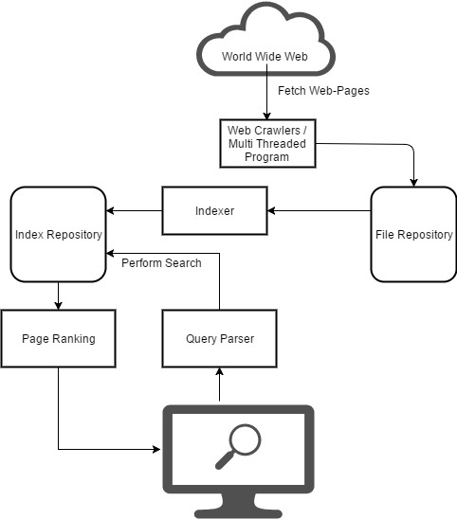
Engineering behind Search engine
A search engine maintains the following processes in real time:
1)Web crawling
2)Indexing
3)Ranking
4)Query Parsing
5)Retrieval

Slide 5
Web-Crawling
What is Spider?
How Spider Works?
Video

Slide 6

How Spider Crawl the web?
Link-4
Link-5
Page-4
Page-1
User-agent:*
Disallow: /Page-6/
Link-1
Link-2
Link-3
Link-6
Spider
Page-5
Page-2
robot.txt
index.html
Access Denied
Page-3
Page-6

Slide 7
What is “robot.txt”
Robots Exclusive Protocol
Example:
A robot wants to visits a Web site URL, say http://www.example.com/welcome.html. Before it does so, it firsts checks for http://www.example.com/robots.txt, and finds:
User-agent: *
Disallow: /filename.html

Slide 8
Indexing
Applying

Slide 9
Page--Ranking
PageRank (PR) is an algorithm used by Google Search to rank websites in their search engine results. PageRank was named after Larry Page.
Let us take an example which can clear the concept.
This algorithm was used by google till 2010. But later it was changed because of some issues of black hat SEO.

Slide 10
Example OF Tradition Page Ranking Algorithm
Example OF Tradition Page Ranking Algorithm
1
1
Website-1
Website-4
1
Website-3
1
1
Website-2
Website-5

Slide 11
Example OF Tradition Page Ranking Algorithm
1
0.5
4+1=5
0.5
Website-1
3.5
Website-4
1+2.5=3.5
1
Website-3
1
1
1
Website-2
Website-5

Slide 12
Example OF Tradition Page Ranking Algorithm
So websites will be shown in below order:
1) Website-4
2) Website-3
3) Website-1
4) Website-2
5) Website-5

Slide 13
Comparisons between Google , Bing and duckduckgo
Google is best for Documents and Websites.
Bing is best for searching Images and Videos.
DuckDuckGo is best for anonyms search.

Slide 14
- Hello! Gordon's pizza? - No sir it's Google's pizza. - So it's a wrong number? - No sir, Google bought it. - OK. Take my order please .. - Well sir, you want the usual? - The usual? You know me? - According to our caller ID, in the last 12 times, you ordered pizza with cheeses, sausage, thick crust - OK! This is it - May I suggest to you this time ricotta, arugula with dry tomato? - No, I hate vegetables - But your cholesterol is not good - How do you know? - Through the subscribers guide. We have the result of your blood tests for the last 7 years - Okay, but I do not want this pizza, I already take medicine - You have not taken the medicine regularly, 4 months ago, you only purchased a box with 30 tablets at Drugsale Network - I bought more from another drugstore - It's not showing on your credit card - I paid in cash - But you did not withdraw that much cash according to your bank statement - I have other source of cash - This is not showing as per you last Tax form unless you got it from undeclared income source -WHAT THE HELL? Enough! I'm sick of Google, Facebook, twitter, WhatsApp. I'm going to an Island without internet,where there is no cell phone line and no one to spy on me - I understand sir, but you need to renew your passport as it has expired 5 weeks ago.

